Slide 1
MySQL Triggers

Slide 2
Introduction
A trigger is a MySQL program, which can be executed automatically by the Oracle server when an event is raised. MySQL Triggers executes before or after an insert, update or delete statement.
MySQL Triggers are fired, when a appropriate event occurs for the table. MySQL Triggers are used to perform verification checks on data values for insertion and perform calculations.

Slide 3
Types of Triggers
MySQL Triggers are of 4 types:
Before Insert Trigger
Before Update Trigger
After Insert Trigger
After Update Trigger

Slide 4
Syntax
create trigger <trigger_name> before insert on <table_name> for each row
BEGIN
— variable declarations
— trigger code
END;
trigger_name => The name of the trigger to be created.
table_name => The accurate table in the database.

Slide 5
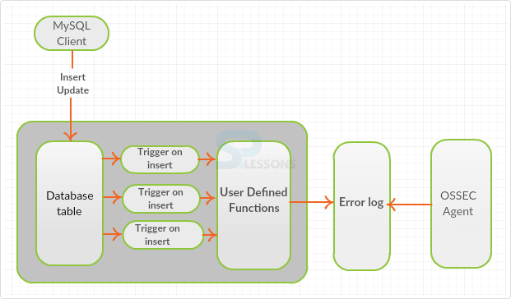
Triggers Functioning

Slide 6
Database table – Set of database elements.
User defined function – Which are defined by the user.
Error log – Error that created during error logs.
OSSES agent – Connection between specific client and server.

Slide 7
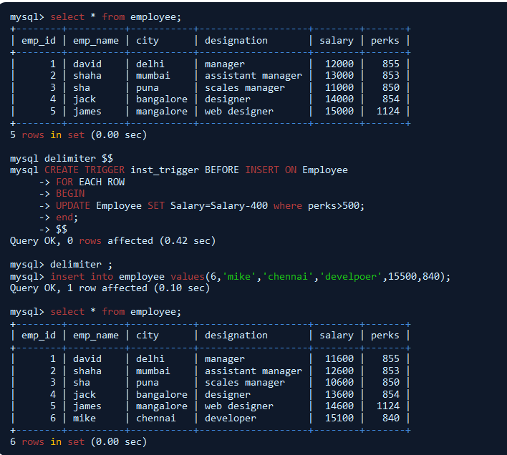

Slide 8
Example
In the above example, before insert, trigger will fire the condition before inserting a record inside the table or on the table, and update command is performed on the column salary(Set Salary=Salary-400 where perks>500). Then the salary of all the employee changes as all the employee perks are greater then the applied condition.

Slide 9
Types
MySQL Before update trigger will fired the trigger before performing update records values inside the table.

Slide 10
Syntax
create trigger <trigger_name> before update on <table_name> for each row
BEGIN
— variable declarations
— trigger code
END;
trigger_name => The name of the trigger to be create.
table_name => The accurate table in the database

Slide 11
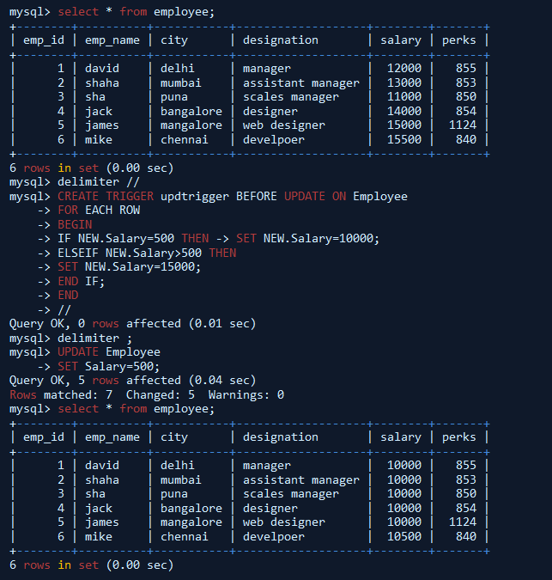

Slide 12
Example
In the above example, before update, MySQL Triggers will fire the condition before updating a record inside the table or on the table, and update command is performed on the column salary(update if Salary=Salary>11000 and perks>500 then change to 10000). Then the salary of all the employee changes, as all the employee perks are greater then the applied condition.

Slide 13
Types
MySQL After Insert trigger will fire the trigger after performing insert records values inside the table.

Slide 14
Syntax
create trigger <trigger_name> AFTER INSERT ON <table_name> FOR EACH ROW
BEGIN
— variable declarations
— trigger code
END;
trigger_name =>The name of the trigger to be create.
table_name => The accurate table in the database.

Slide 15
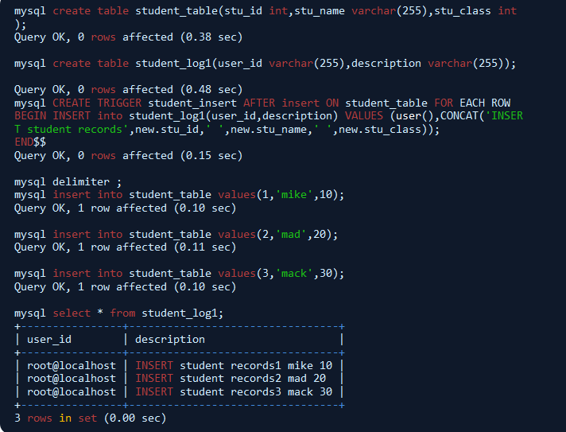

Slide 16
Example
In the above example, after insert, trigger will fire the condition after inserting a record inside the table or on the table i.e, after creating student_insert table, it will fire on the student_log1 table and all the values will display on student_log1 table which was inserted in student_table.

Slide 17
Types
MySQL After update trigger of MySQL Triggers will fire the trigger after performing insert records values inside the table.

Slide 18
Syntax
create trigger <trigger_name> AFTER UPDATE ON <table_name> FOR EACH ROW
BEGIN
— variable declarations
— trigger code
END;
trigger_name => The name of the trigger to be create.
table_name => The accurate table in the database.

Slide 19
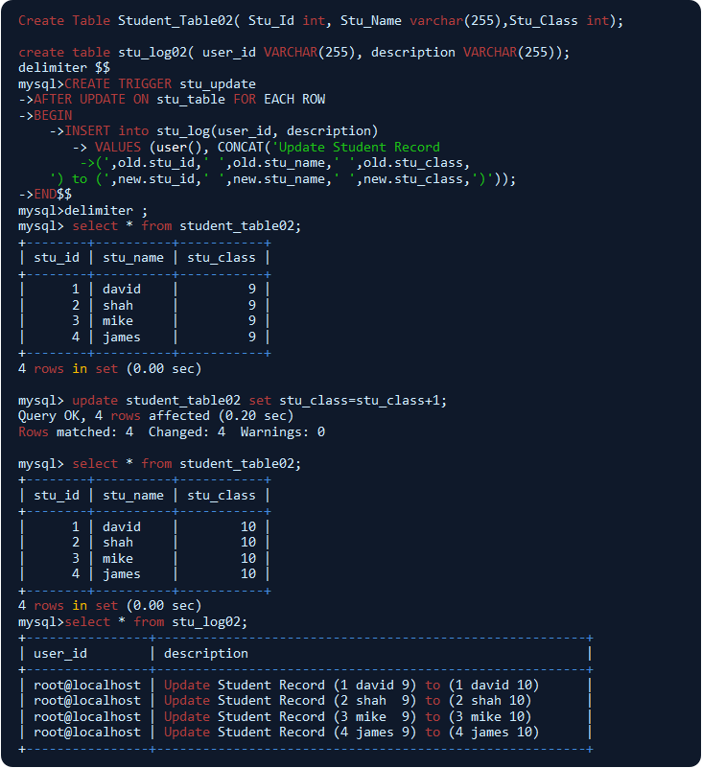

Slide 20
Example
In the above example, after update, trigger will fire the condition after update a record inside the table or on the table. i.e, after creating student_update table it will fire on the student_log2 table and all the values will display on student_log2 table which was inserted in student_table02.

Slide 21
Thank You

